Slide 1

Recitation 13 /////

Slide 2
Announcements
HW08 due this Thursday (11/18)
Optional PE06 released this Friday (11/19)
REMINDER! JavaFX Activity next Monday (11/22)

Slide 3
TA HIRING!
If you are interested in being a TA for this class, please apply!!!
The application link is here: https://ta-app.cc.gatech.edu/
Also, check out the TA info PowerPoint on Canvas in Modules!
If you have any questions about the process or responsibilities go ahead and ask your recitation TAs now!!!

Slide 4
Kahoot
https://create.kahoot.it/share/quiz-5-review/b5ab5cb0-f2a3-460c-9b38-cde6d737cc0c

Slide 5
Topics
JavaFX2 : Event-driven programming
JavaFX3 : GUI controls
JavaFX4: Mouse & key events

Slide 6
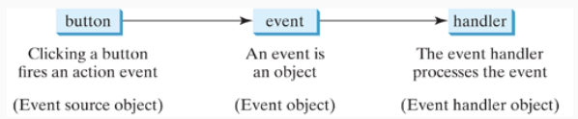
Java FX – Event Driven Programming
Represented through Event Objects
Events that occur are outputted from the source Object (i.e. Buttons)
EventHandlers controls what to do if an Event occurs

Slide 7
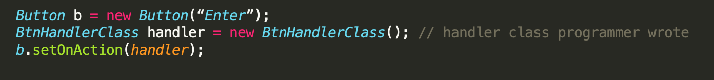
Java FX – Events/EventHandler
Event object holds details of what happened
EventHandler object processes that event
Must be an instance of EventHandler<T extends Event> interface
Must be registered with an event source object through the source.setOnAction(handler) method

Slide 8
Java FX – Event General Process
User clicks a button
Button creates and fires ActionEvent
ActionEvent passed to handler's handle(event) method
Event is handled depending on program's specific implementation

Slide 9
Java FX – Implementing EventHandler
3 main approaches to handle events: Inner Classes, Anonymous Inner Classes, & Lambda Expressions
Inner classes: Declaring a class within the body of another class, but outside of all the methods
Anonymous Inner Classes: Inner class declared without a class name (we declare and instantiate them at the same time), which are often used to override the method of a class/interface
Lambda Expressions: Enable us to treat functionality as a method argument

Slide 10
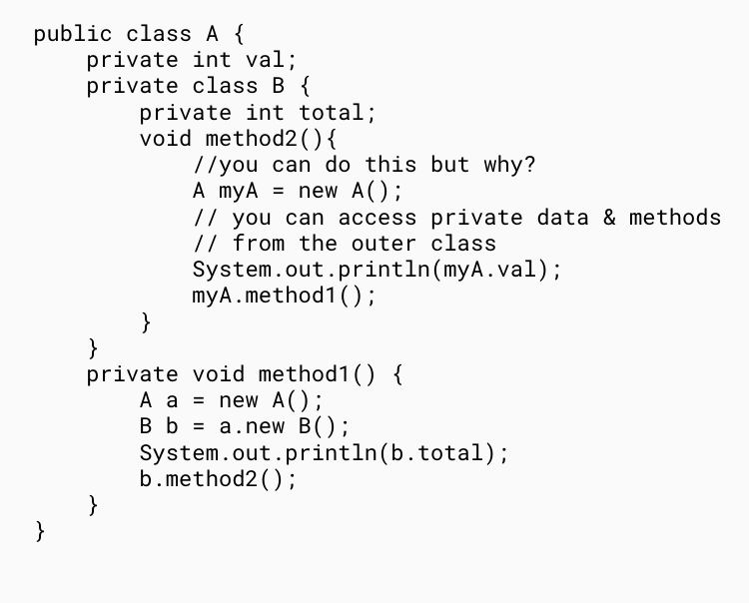
Inner Classes
Inner nested classes belong to their enclosing classes, therefore, they have access to their private attributes and methods
Can do everything a normal class can
Are usually private

Slide 11
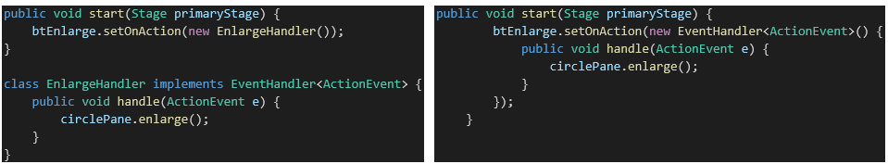
Anonymous Inner Classes
Similar to an inner class, but without a class name (declared and instantiated at the same time)
Can hinder readability and reuse; often used for a one-time event handler
Inner Class:
Anonymous Inner Class:

Slide 12
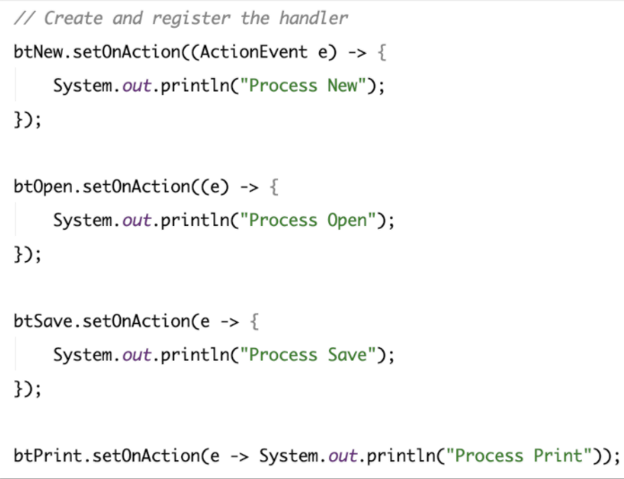
Lambda Expressions
Like anonymous method
implementations
Can only be used to implement an interface with a single method (a functional interface)
Syntax: 3 parts
1. Argument list
2. Arrow token
3. Body
Parenthesis can be omitted if there is only 1 parameter without specific data type

Slide 13
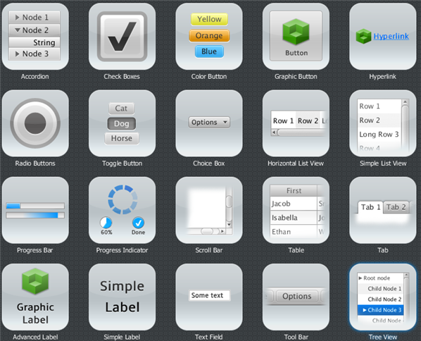
GUI Controls

Slide 14
Labels, Buttons, and TextFields
Labels are non-editable text controls that can contain an image. You can modify their font, scale, alignment, icon, wrapping, among others.
Buttons are actionable elements that can contain text and/or graphics. Event handling allows for a certain action to occur when it is pushed.
The method setOnAction(EventHandler<ActionEvent> handler) can be used to handle button presses.
TextFields are text input components which allow for a single line of text entry.
Note: An ActionEvent will fire when the enter key is pressed on the field and is handled similar to a Button.

Slide 15
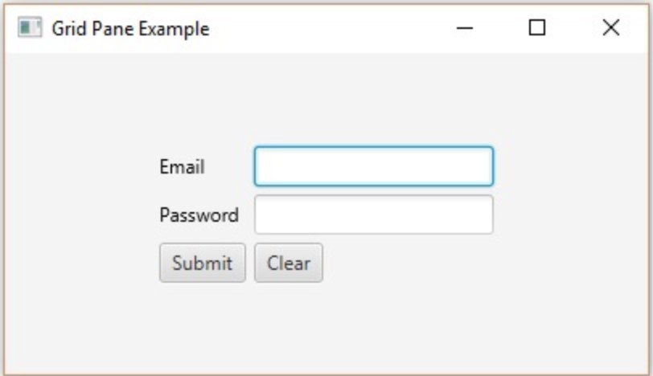
A Quick Example...
Label
TextField
Button

Slide 16
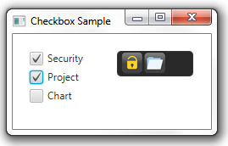
Checkbox
A selection control represented with a checkmark.
Checking or unchecking will fire an ActionEvent.
You can utilize the same event handler for multiple checkboxes in conjunction with the isSelected() method to determine the boxes that are checked.

Slide 17
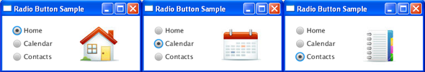
RadioButton
A selection control in which only one item can be selected from a series of items.
Creating a ToggleGroup is important as it will handle the 1-of-many selection for you. To add a RadioButton to a ToggleGroup use bt.setToggleGroup(group).
Pressing and releasing a RadioButton will fire an ActionEvent.

Slide 18
ComboBox
List which enables users to choose one of several options. If the number of items exceeds a limit, it automatically adds scrolling to the dropdown list.
You can instantiate a ComboBox utilizing generics as follows:
ComboBox<String> combo = new ComboBox<>();
To add elements the addAll() method is useful:
combo.getItems().addAll("1331", "1332", "2340");
Selecting an item will fire an ActionEvent.

Slide 19
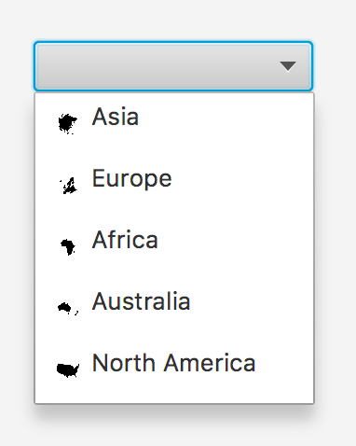
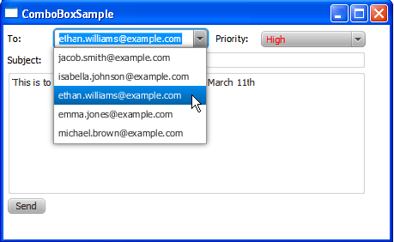
ComboBox Examples

Slide 20
JavaFX – Mouse Events
Fired when mouse button is pressed, released, clicked, moved, or dragged.
Every mouse event has an associated MouseButton (an enum).
Multiple ways to define their behavior by using methods like...
1. setOnMousePressed(...)
2. setOnMouseReleased(...)
3. setOnMouseClicked(...)
4. setOnMouseEntered(...)
5. setOnMouseDragged(...)
6. setOnMouseMoved(...)
Sources can vary (for example, Nodes and Scenes can fire mouse events too).
Check out the documentation for more!

Slide 21
MouseEvent Class
Event indicating that a mouse action occurred in an element.
Has an associated MouseButton enum to identify the button responsible for the event. Available values are PRIMARY, SECONDARY, MIDDLE, NONE.
Associated with the getButton() method to obtain information about the mouse button that triggered the event (if any).
There are more constants related to the event that happened on the mouse like MOUSE_CLICKED, MOUSE_DRAGGED, MOUSE_ENTERED...

Slide 22
Useful MouseEvent Methods
Method​ | Definition​
getButton()​ | Returns the MouseButton that was responsible for the event (if any).
getX() | Retur​ns the horizontal position of the mouse event relative to the originating source.
getY() | Returns the vertical position of the mouse event relative to the originating source.
getClickCount() | Returns the number of clicks for an event.
isShiftDown() | Returns whether Shift was down for this event.
isControlDown() | Returns whether Control was down for this event.

Slide 23
JavaFX – Key Events
Fired whenever a key is pressed, released or typed.
Every key event has an associated KeyCode (an enum).
Multiple ways to define their behavior by using methods like...
1. setOnKeyPressed(...)
2. setOnKeyReleased(...)
3. setOnKeyTyped(...)
Sources can vary (for example, Nodes and Scenes can fire key events too).
Check out the documentation for more!

Slide 24
KeyEvent Class
The implementation which indicates that a keystroke action occurred in a component.
Has an associated KeyCode enum to identify the key being pressed.
Associated with the getCode() method to obtain information about the key button that was pressed or released.
There are more class-level constants related to the event that happened on the key like KEY_PRESSED, KEY_RELEASED, KEY_TYPED...

Slide 25
Useful KeyEvent Methods
Method​ | Definition​
getCode() | Returns the key code associated with a key pressed or key released event.
getCharacter() | Returns the character or sequence of characters associated with a key typed event.
getText() | Returns a String describing a particular key code for key pressed or key released events.
isShiftDown() | Returns whether Shift was down for this event.
isControlDown() | Returns whether Control was down for this event.

Slide 26
Check the documentation for more!
Note that there are many, many more GUI controls.
Be sure to familiarize yourself with the JavaFX API to learn more!
https://openjfx.io/javadoc/11/

